Slide 1
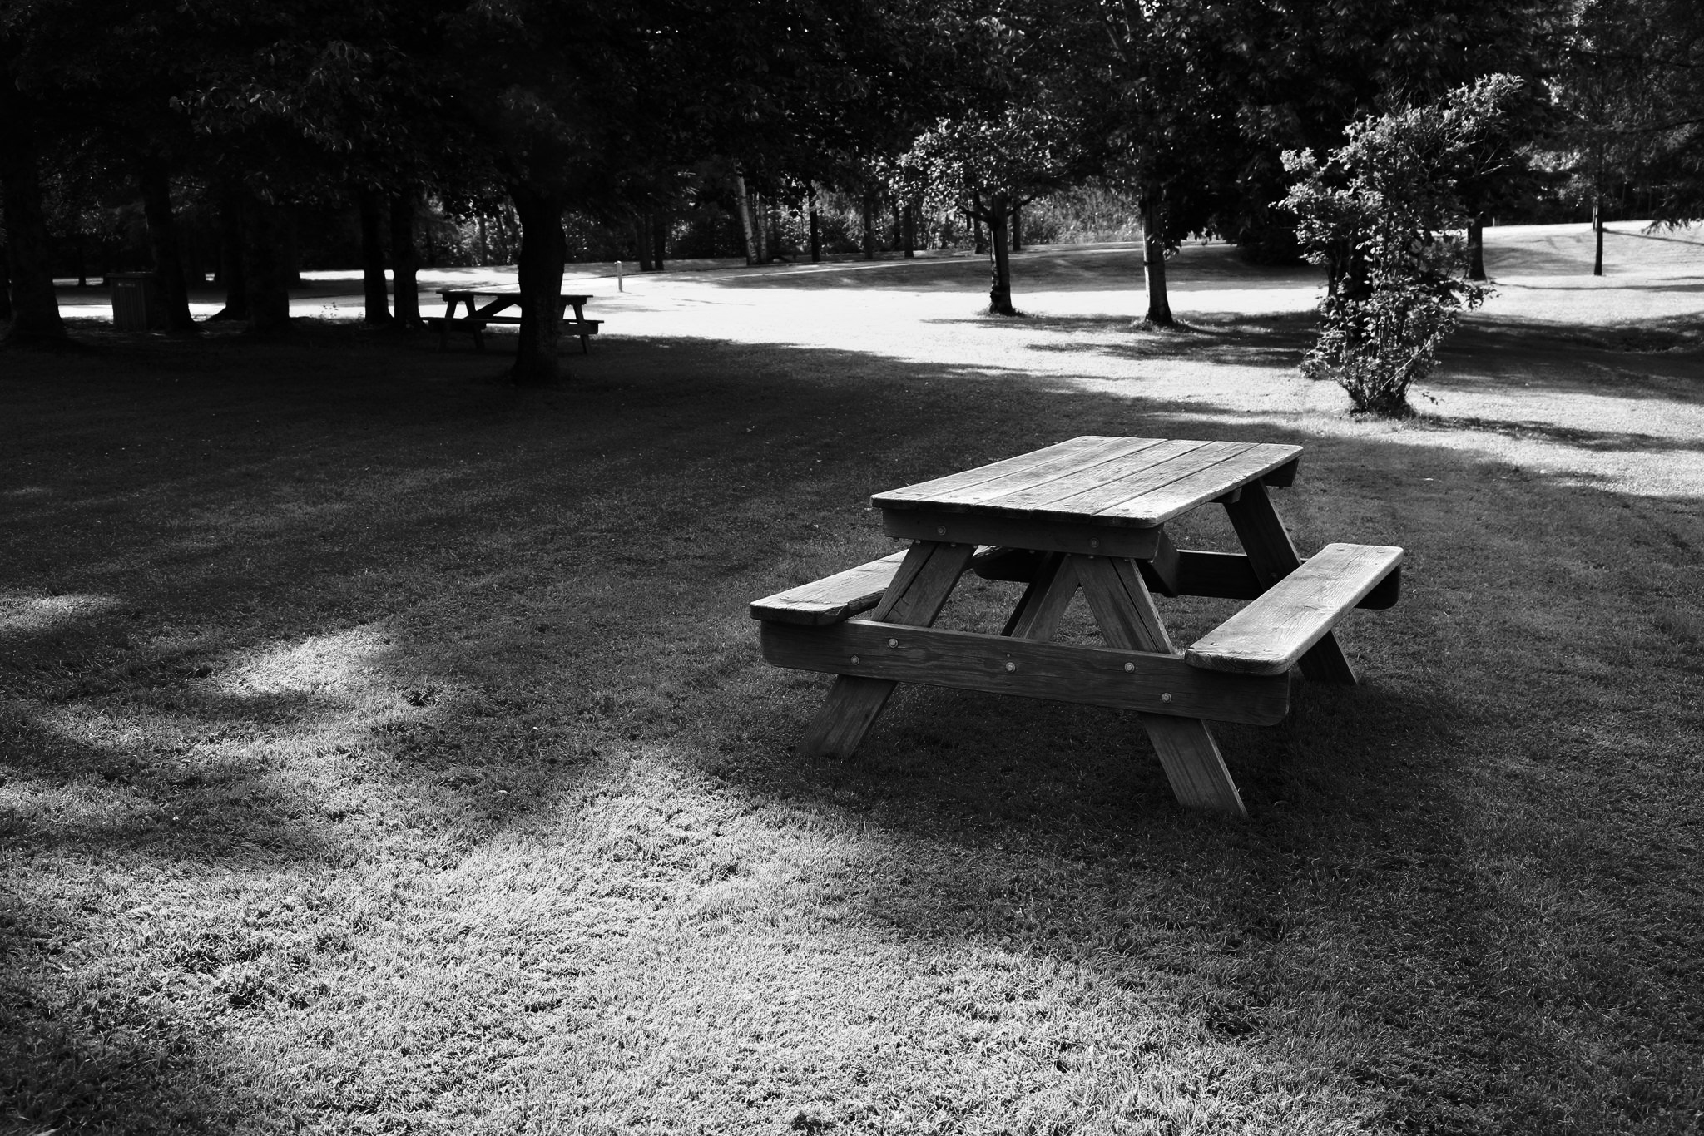
Park Picnic Planner
Imagined By: Joshua Gould, Thuson Sivagnanam, Kekoa Sylva

Slide 2

Description
Park Picnic Planner is our mobile app-dev project.
It is designed to help people plan and participate in picnics (meetups).
You can conduct a poll to schedule a picnic as well as set the location and any suggested items to bring once a picnic is scheduled.

Slide 3
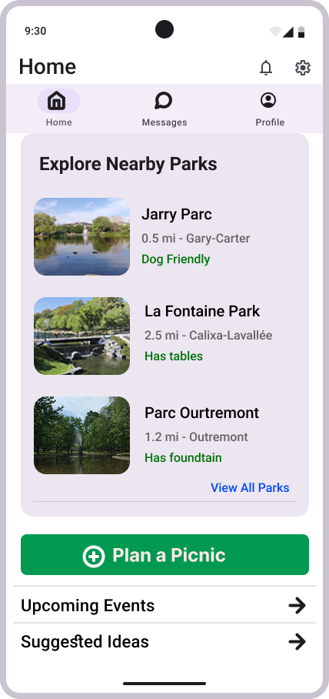
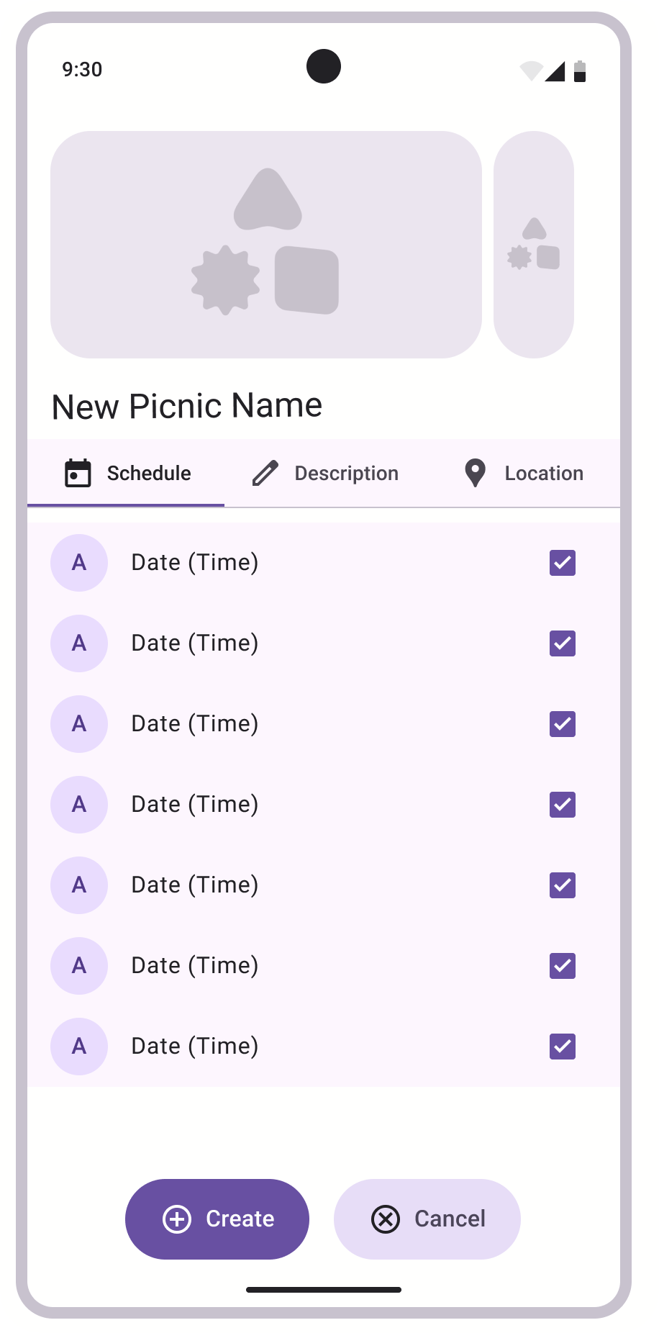
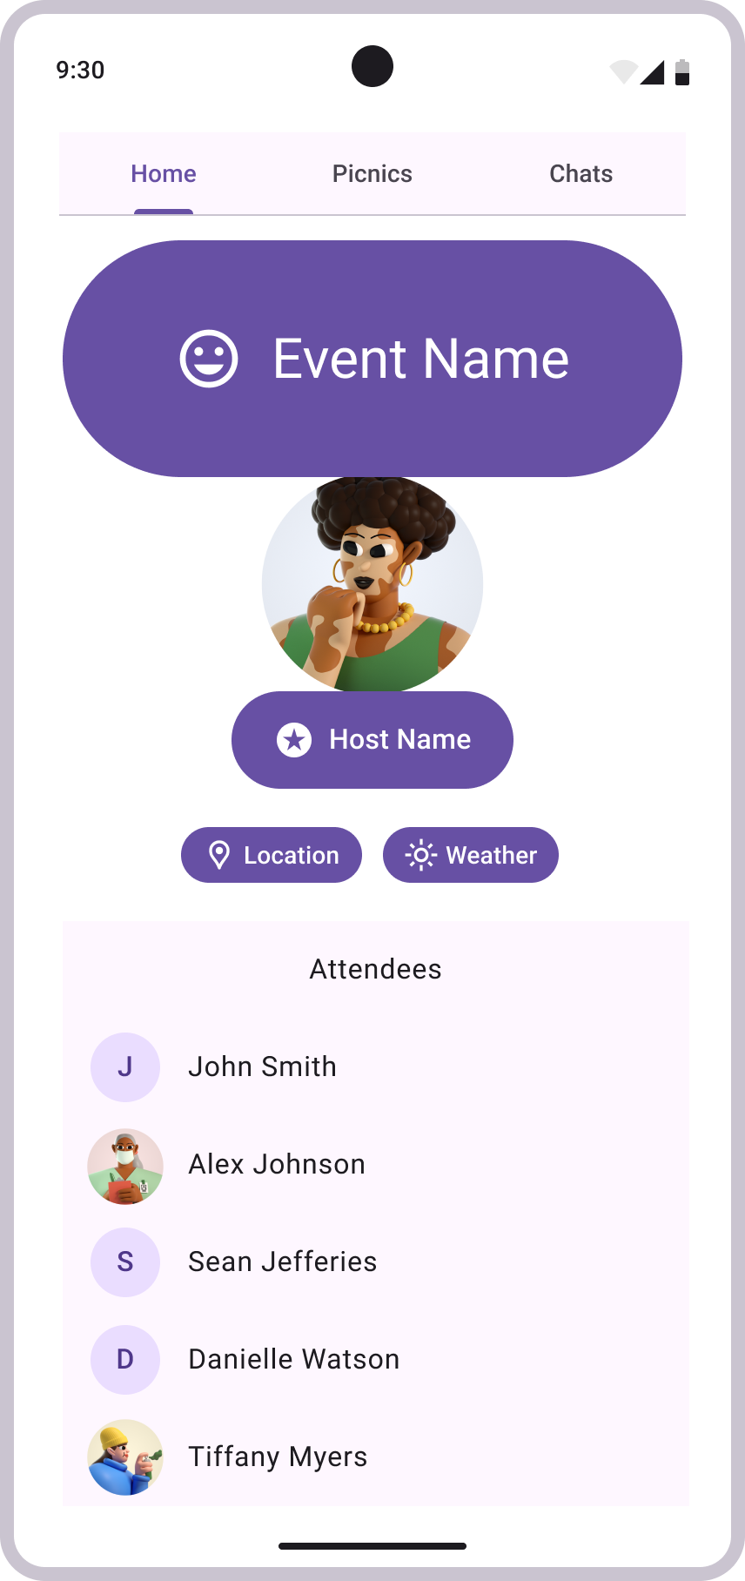
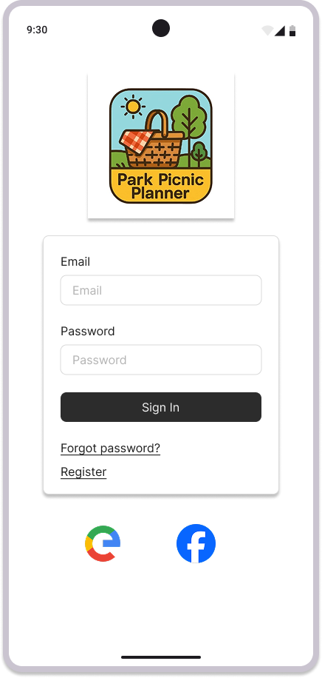
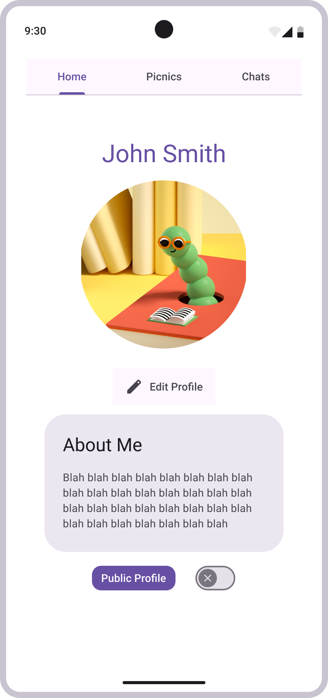
Picnic App Mock-Up

Slide 4
Home Screen/Login Screen
This is the first screen of our app. It will prompt you to either login or register in order to access other functionalities.
You may sign in with Google or Facebook or with an email address.

Slide 5
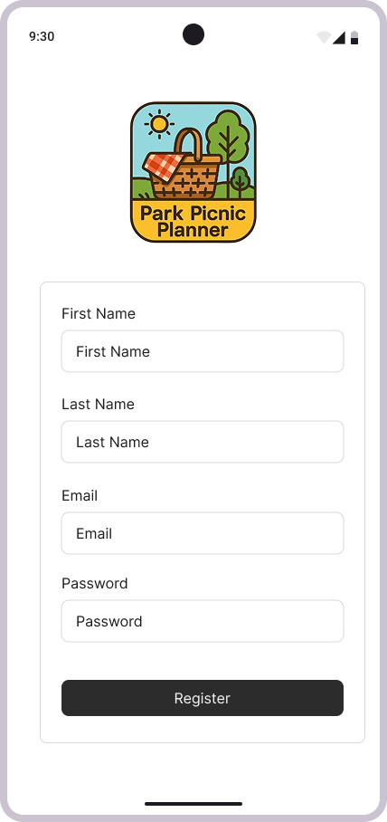
Registration Screen
This is our registration screen. It prompts you to enter a first name, a last name, an email, an username and a password.

Slide 6
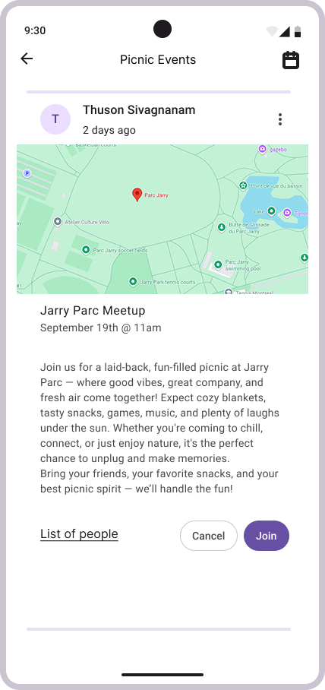
Picnic/Meetup Overview Screen
This is the meetup overview screen.
It displays the meetup details—who posted it, when and where it’s happening including a map, a brief description, and options to see attendees, cancel, or join the event

Slide 7
Homepage
This is the homepage after you log in.
It displays nearby parks to explore—each with a name, picture, and distance—tapping one opens full details, while 'View All Parks' shows the complete list. Below, a 'Plan a Picnic' button helps organize new meetups. The 'Upcoming Events' section previews scheduled gatherings, and 'Suggest Idea' recommends parks, food, and ratings for your outing. The top navigation includes Home, Messages, Profile, Notifications, and Settings for quick access

Slide 8
Account Profile Screen
This page displays the user’s profile.
The user has the ability to edit their profile picture, their
“About Me”, and the option to set their profile to private
or public.

Slide 9
Schedule Picnic Screen
This page allows you to schedule (or poll) for a picnic.
It displays the available day/time slots.
Allows you to set a description / location.

Slide 10
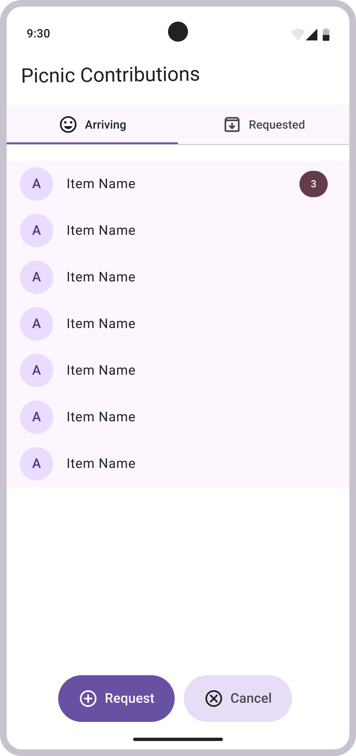
Picnic Contributions Screen
This page displays optional requested (or present) items for the picnic.
Allows for easy coordination and last-minute requests.
Helps prevent situations where people only bring chips.

Slide 11
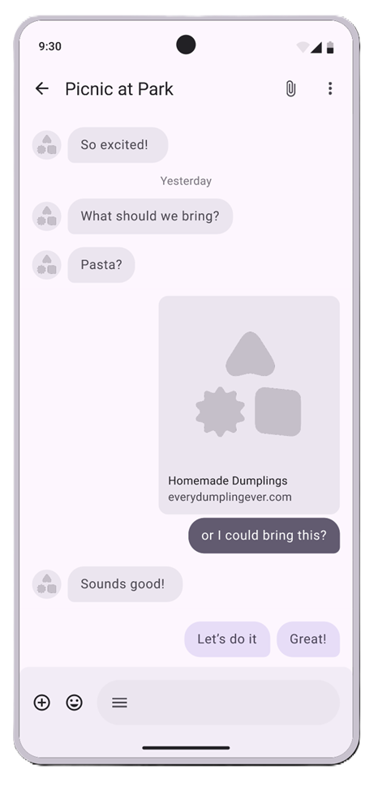
Picnic Group Chat Screen
This page displays the conversation thread for a given picnic.
It allows for quick responses and requests.
Users will have the option of being notified when they are mentioned.

Slide 12
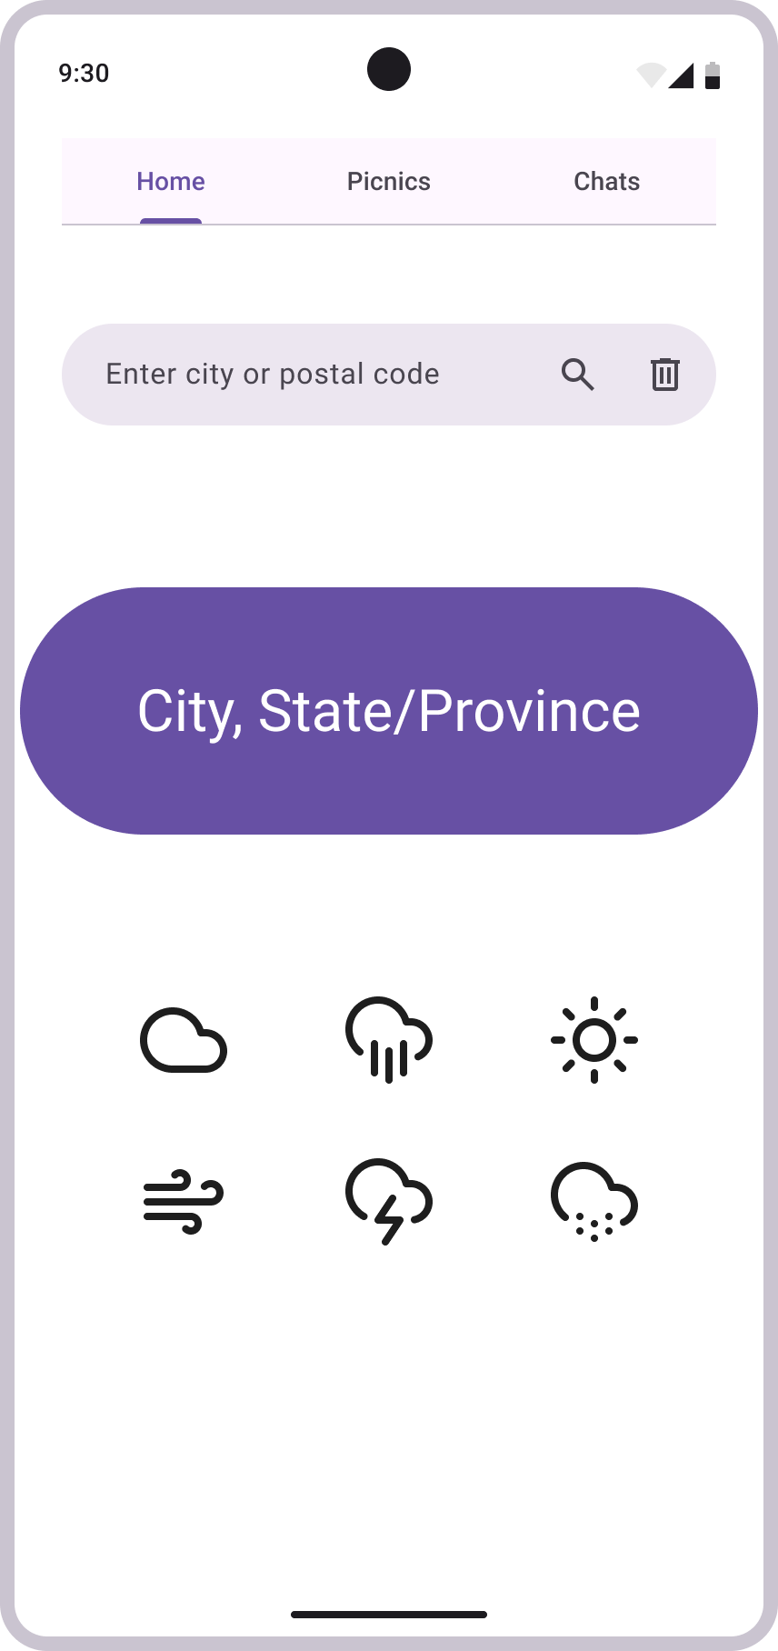
Weather Forecast Screen
This page displays the weather, pulling data from a weather API.
The user can search by city or postal code to view the local weather forecast.

Slide 13
Picnic Attendance Screen
This page displays a scheduled event.
The user can see who is hosting, the location, access a link to the weather forecast page, and the confirmed attendees.

Slide 14
Additional Information
Project Management Style: Agile
Number of screen flows: ~10 screens
Selected Database: Firebase
GitHub Repo: https://github.com/adinashby-vanier-college/app-dev-2-project-parkpicnicplanner

